Slide 1
Memory management and Garbage collection in JAVA

Slide 2
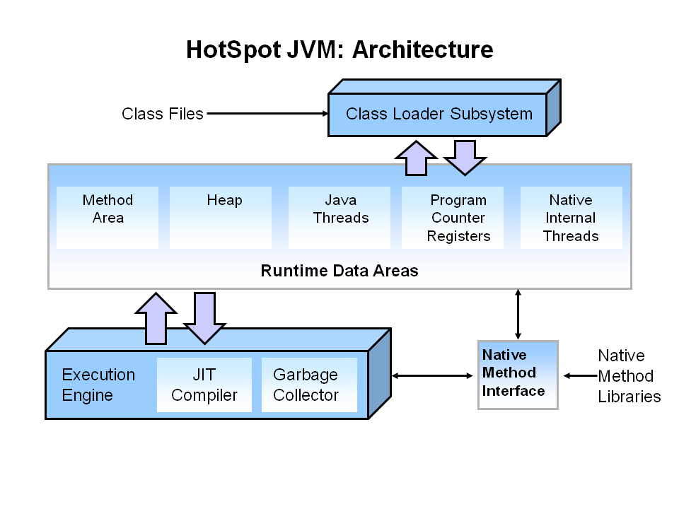
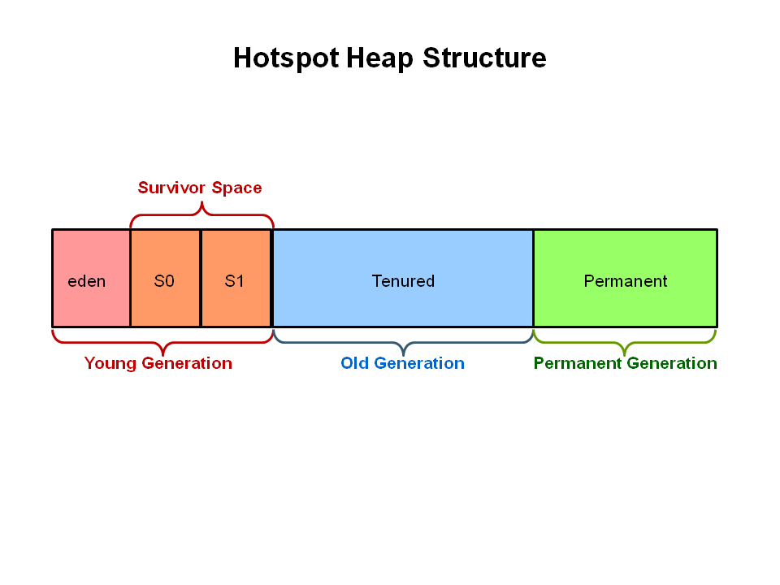

Slide 3
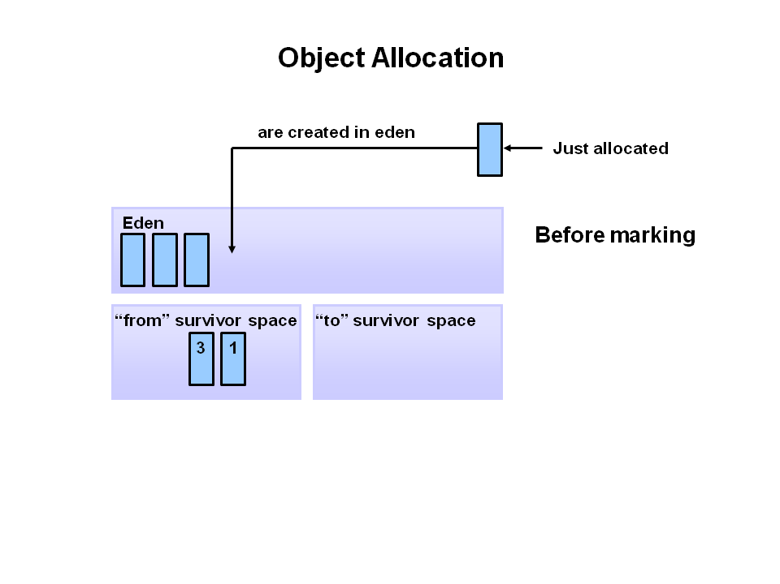
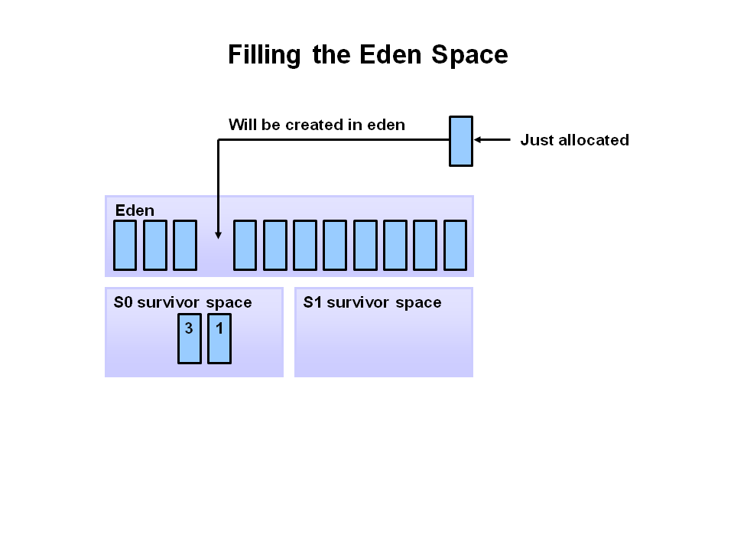

Slide 4
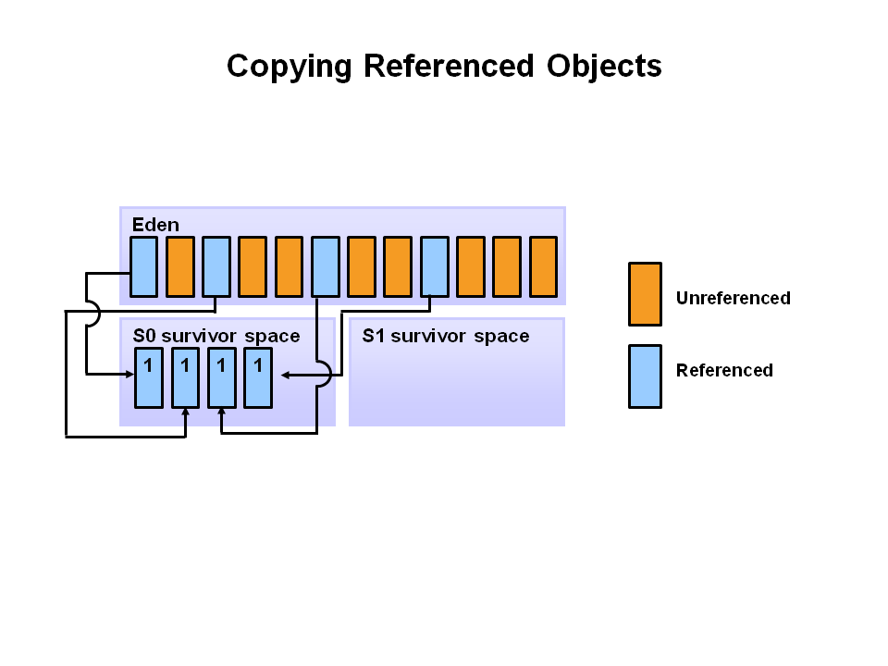
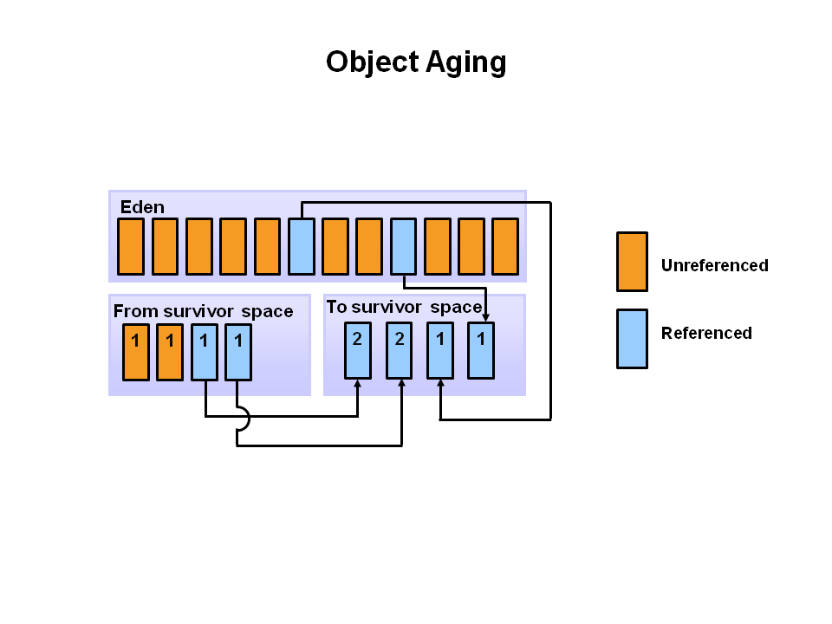

Slide 5
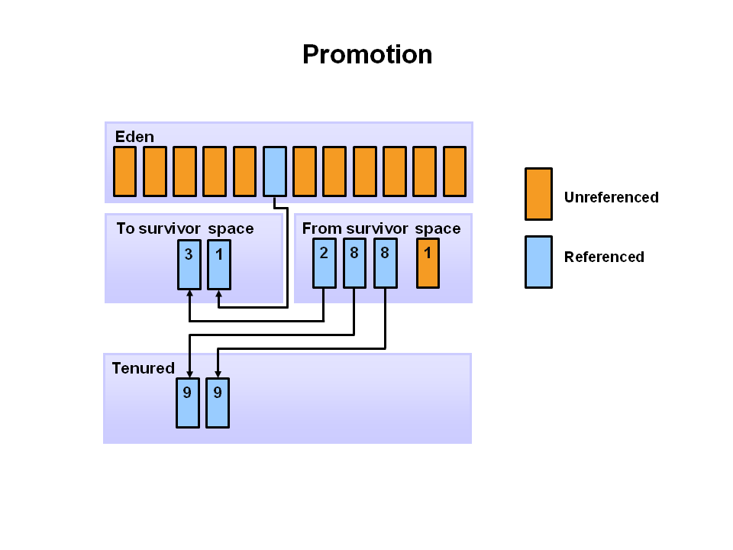
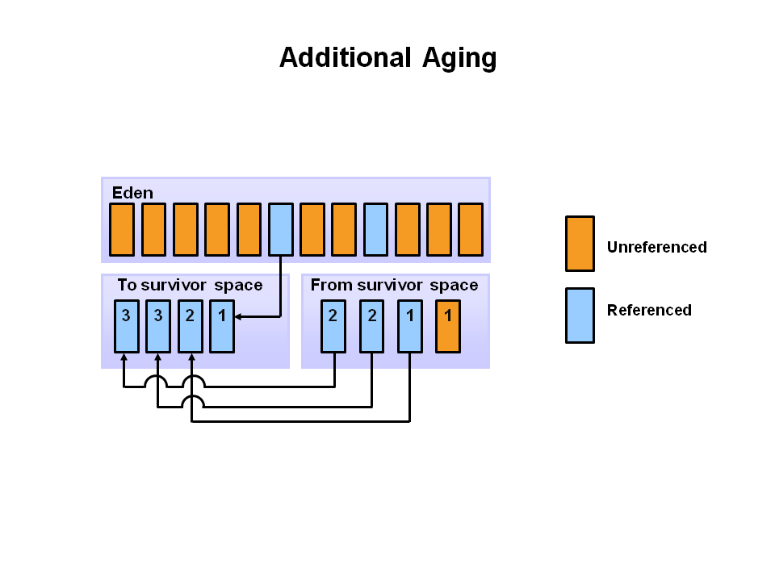

Slide 6
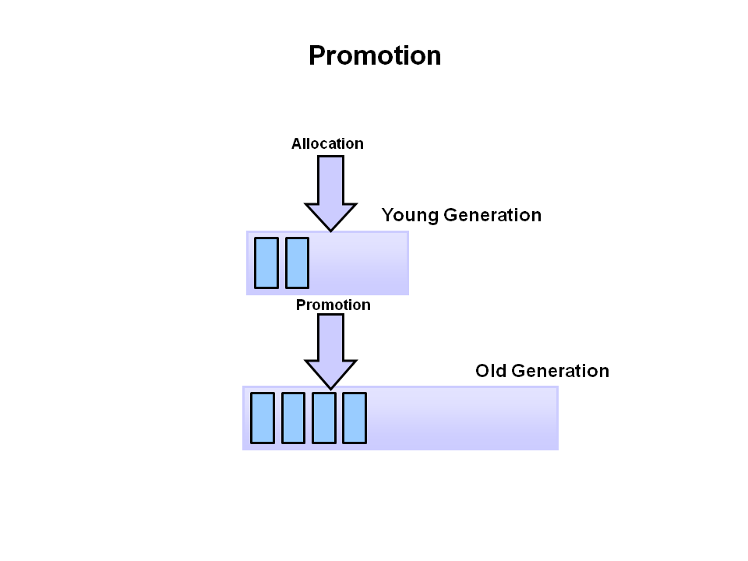

Slide 7
When object will be Grbage collcted ?
By nulling the reference
Employee e=new Employee();
e=null;
By assigning a reference to another
Employee e1=new Employee();
Employee e2=new Employee();
e1=e2;//now the first object referred by e1 is available for garbage collection
By anonymous object etc.
new Employee();

Slide 8
Methods to be called ?
finalize() method (protected void finalize(){} )
Note : The Garbage collector of JVM collects only those objects that are created by new keyword. So if you have created any object without new, you can use finalize method to perform cleanup processing (destroying remaining objects).
gc() method ( public static void gc(){} )
Note: Garbage collection is performed by a daemon thread called Garbage Collector(GC). This thread calls the finalize() method before object is garbage collected.

